Slide 1

Skill Barter Android APP
By Noa Binenbaum and Jenny Kapul
Guided by Hovav Gazit

Slide 2
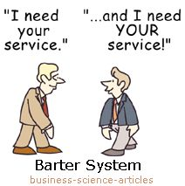

Slide 3
Motivation
Skills and services exchange
!Money
Meet new people based on interests
No need in “favors”
Improve your skills and acquire new ones
Notes:
Create a new platform for skills and services exchange free of charge
Gain points by offering services based on your skills
Receive services in exchange for point gained
Supervise the quality of services offered by sustaining up to date ranking system
Eliminate completely the need of money exchange between users
Allows flexible and constantly adjustable schedule for services offered

Slide 4





Implementation Plan
Native Java
Android Studio IDE
Firebase framework
Google maps and calendar services
UX/UI design

Slide 5
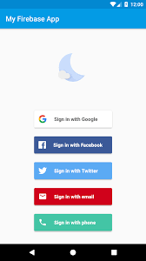
Features
Skill Barter App
Authentication
Notes:
Easy authentication integrating Facebook, Google, Tweeter accounts
Allow sign-up for Technion students only (by Technion e-mail verification)
Each user can constantly change and modify services offered by him and his interests
Set the location of offered services
Set for each service offered the amount of requested points per service unit
Advanced search with filters:
By field / location (static or dynamic) / ranking etc
Ranking and dispute resolution system to increase users satisfaction
The ranking is mutual – both the user offering the service and the user receiving one
Instant messaging system – for secure and easy interaction between users

Slide 6
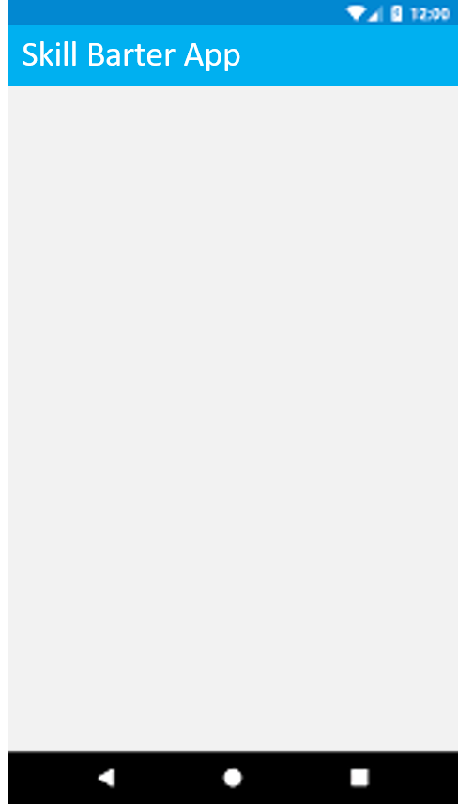
Features
Authentication
Technion students only
Technion Authentication
Please enter your valid Technion e-mail address
Send
Notes:
Easy authentication integrating Facebook, Google, Tweeter accounts
Allow sign-up for Technion students only (by Technion e-mail verification)
Each user can constantly change and modify services offered by him and his interests
Set the location of offered services
Set for each service offered the amount of requested points per service unit
Advanced search with filters:
By field / location (static or dynamic) / ranking etc
Ranking and dispute resolution system to increase users satisfaction
The ranking is mutual – both the user offering the service and the user receiving one
Instant messaging system – for secure and easy interaction between users

Slide 7



Features
Authentication
Technion students only
User profile details
User Information
User Information
First Name
Please attach recent and recognizable photo of yourself
Last Name
Birthday
Phone number
Address
Gender
Next
Next
Notes:
Easy authentication integrating Facebook, Google, Tweeter accounts
Allow sign-up for Technion students only (by Technion e-mail verification)
Each user can constantly change and modify services offered by him and his interests
Set the location of offered services
Set for each service offered the amount of requested points per service unit
Advanced search with filters:
By field / location (static or dynamic) / ranking etc
Ranking and dispute resolution system to increase users satisfaction
The ranking is mutual – both the user offering the service and the user receiving one
Instant messaging system – for secure and easy interaction between users

Slide 8


Features
Skill Barter App
Skill Barter App
Authentication
Technion students only
User profile details
Your Skills:
Your Skills:
Piano
Cooking
Piano
Cooking
Choose category…
Sports
Choose skill…
Choose skill…
Cycling
Dance
Swimming
Tennis
Yoga
Add
Add
Notes:
Easy authentication integrating Facebook, Google, Tweeter accounts
Allow sign-up for Technion students only (by Technion e-mail verification)
Each user can constantly change and modify services offered by him and his interests
Set the location of offered services
Set for each service offered the amount of requested points per service unit
Advanced search with filters:
By field / location (static or dynamic) / ranking etc
Ranking and dispute resolution system to increase users satisfaction
The ranking is mutual – both the user offering the service and the user receiving one
Instant messaging system – for secure and easy interaction between users

Slide 9
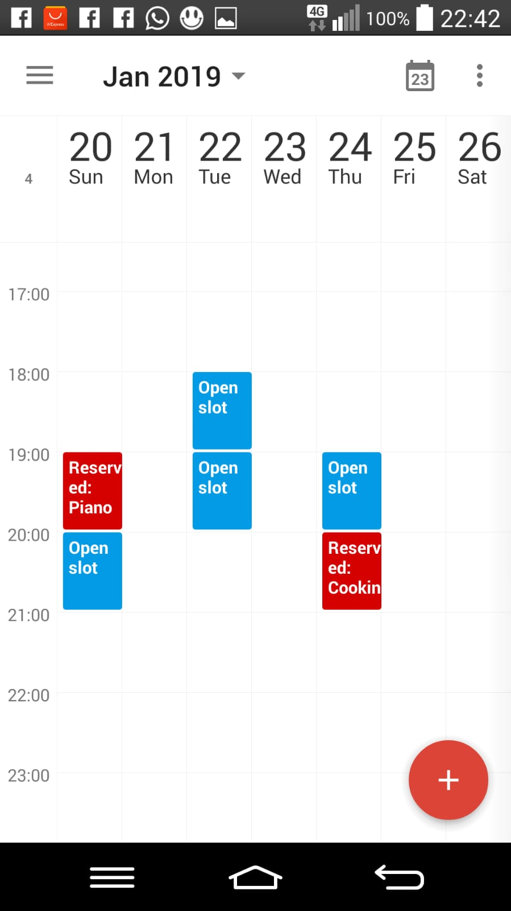
Features
Skill Barter App
Authentication
Technion students only
User profile details
Dynamic schedule
Notes:
Easy authentication integrating Facebook, Google, Tweeter accounts
Allow sign-up for Technion students only (by Technion e-mail verification)
Each user can constantly change and modify services offered by him and his interests
Set the location of offered services
Set for each service offered the amount of requested points per service unit
Advanced search with filters:
By field / location (static or dynamic) / ranking etc
Ranking and dispute resolution system to increase users satisfaction
The ranking is mutual – both the user offering the service and the user receiving one
Instant messaging system – for secure and easy interaction between users

Slide 10




Features
Skill Barter App
Skill Barter App
Authentication
Technion students only
User profile details
Dynamic schedule
Search with filters
Search:
Search:
WHAT
Choose categories…
WHAT
Music, Sports
Household Assistance
Music
Sports
Tutoring
Visual Arts
Choose skills…
Choose skills…
WHERE
WHERE
Drums
Guitar
Piano
Tennis
Violin
Distance from me:
current default
0 10Km
Distance from me:
current default
0 10Km
WHEN
S M T W T F S
8:00-12:00 12:00-16:00
16:00-20:00 20:00-00:00
WHEN
S M T W T F S
8:00-12:00 12:00-16:00
16:00-20:00 20:00-00:00
Limit by points:
from to
Limit by points:
from to
Notes:
Easy authentication integrating Facebook, Google, Tweeter accounts
Allow sign-up for Technion students only (by Technion e-mail verification)
Each user can constantly change and modify services offered by him and his interests
Set the location of offered services
Set for each service offered the amount of requested points per service unit
Advanced search with filters:
By field / location (static or dynamic) / ranking etc
Ranking and dispute resolution system to increase users satisfaction
The ranking is mutual – both the user offering the service and the user receiving one
Instant messaging system – for secure and easy interaction between users

Slide 11
Features
לבנות view עבור תוצאות חיפוש
Skill Barter App
Skill Barter App
Authentication
Technion students only
User profile details
Dynamic schedule
Search with filters
Search:
WHAT
Music, Sports
Piano, Violin, Yoga
WHERE
Distance from me:
current default
0 3.3Km
WHEN
S M T W T F S
8:00-12:00 12:00-16:00
16:00-20:00 20:00-00:00
Limit by points:
from to
Notes:
Easy authentication integrating Facebook, Google, Tweeter accounts
Allow sign-up for Technion students only (by Technion e-mail verification)
Each user can constantly change and modify services offered by him and his interests
Set the location of offered services
Set for each service offered the amount of requested points per service unit
Advanced search with filters:
By field / location (static or dynamic) / ranking etc
Ranking and dispute resolution system to increase users satisfaction
The ranking is mutual – both the user offering the service and the user receiving one
Instant messaging system – for secure and easy interaction between users

Slide 12
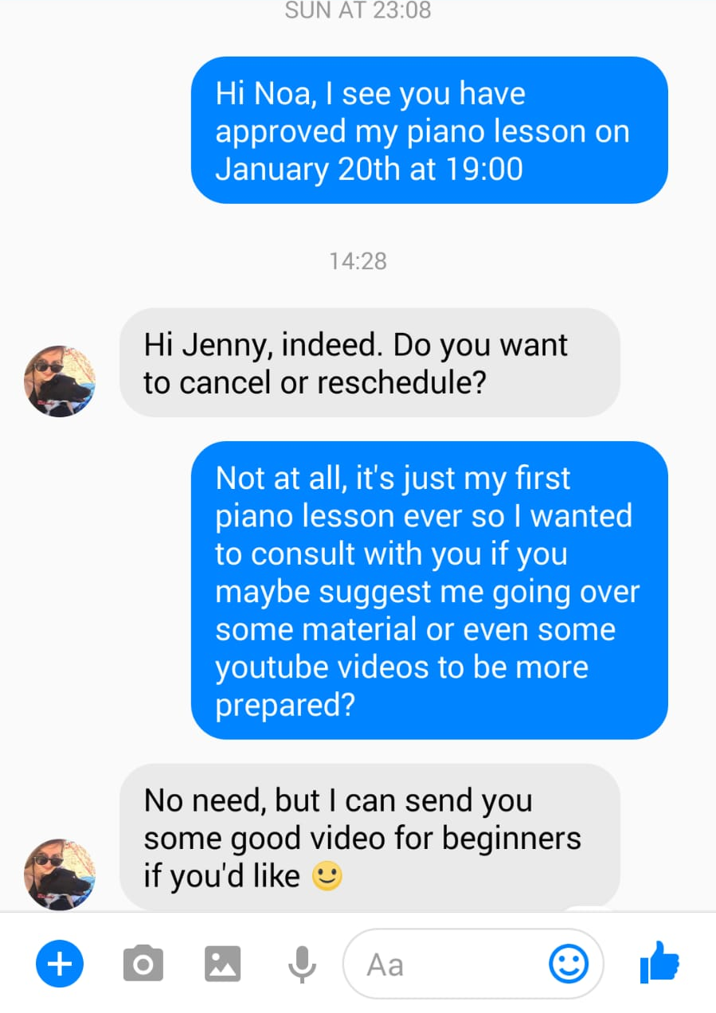
Features
Skill Barter App
Authentication
Technion students only
User profile details
Dynamic schedule
Search with filters
In-app messenger
Notes:
Easy authentication integrating Facebook, Google, Tweeter accounts
Allow sign-up for Technion students only (by Technion e-mail verification)
Each user can constantly change and modify services offered by him and his interests
Set the location of offered services
Set for each service offered the amount of requested points per service unit
Advanced search with filters:
By field / location (static or dynamic) / ranking etc
Ranking and dispute resolution system to increase users satisfaction
The ranking is mutual – both the user offering the service and the user receiving one
Instant messaging system – for secure and easy interaction between users

Slide 13
Optional Features
Ranking
Dispute resolution
Administrator interface
Addition of new skill by user
Notes:
Easy authentication integrating Facebook, Google, Tweeter accounts
Allow sign-up for Technion students only (by Technion e-mail verification)
Each user can constantly change and modify services offered by him and his interests
Set the location of offered services
Set for each service offered the amount of requested points per service unit
Advanced search with filters:
By field / location (static or dynamic) / ranking etc
Ranking and dispute resolution system to increase users satisfaction
The ranking is mutual – both the user offering the service and the user receiving one
Instant messaging system – for secure and easy interaction between users

Slide 14
Skill Barter App
Skill Barter App
Search:
WHAT
Music, Sports
Piano, Violin, Yoga
WHERE
Distance from me:
current default
0 10Km
WHEN
S M T W T F S
8:00-12:00 12:00-16:00
16:00-20:00 20:00-00:00
Limit by points:
from to

